Slide 1

Combustion Engineering Case Study
Technical Development Program for Process Performance Engineers – SPREAD 2016
Mirko Weber

Slide 2
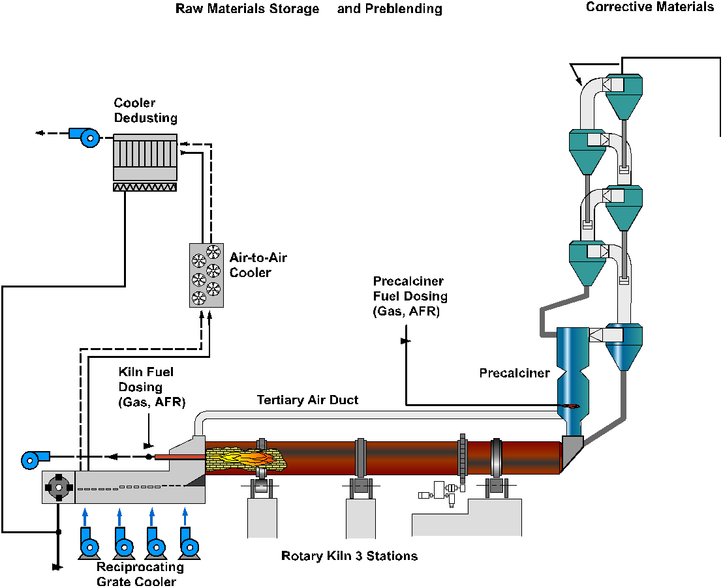
What is the air flow velocity in the tertiary air duct?
Kiln system
Process + Equipment data
Heat consumption: q = 3.2 MJ/kg_{cli}
Production: 4000 tpd
Fuel split: 40% MB (main burner) 60% PC (precalciner)
O₂: 4.0% @ kiln inlet (KI) 3.0% @ precalciner exit (PC)
Primary air PC: not installed
Kiln inlet false air: 0.02 Nm³/kg_{cli}
Neglect fuel transport air (in PC)
Calcination degree at KI: %decarb = 92%
Diameter tertiary air duct: D_{TA}= 2.3 m (inside refractory)
Tertiary air temperature: 900°C
Pressure in TA duct: -5 mbar
Ambient pressure: 980 mbar
v = ?m/s

Slide 3
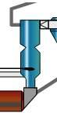
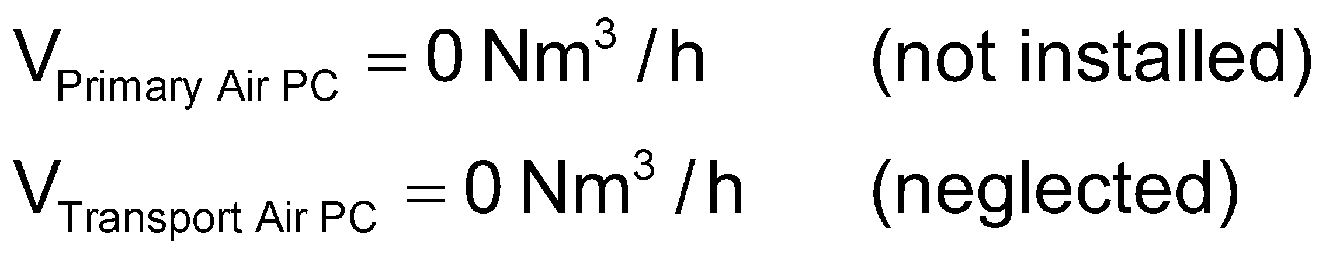
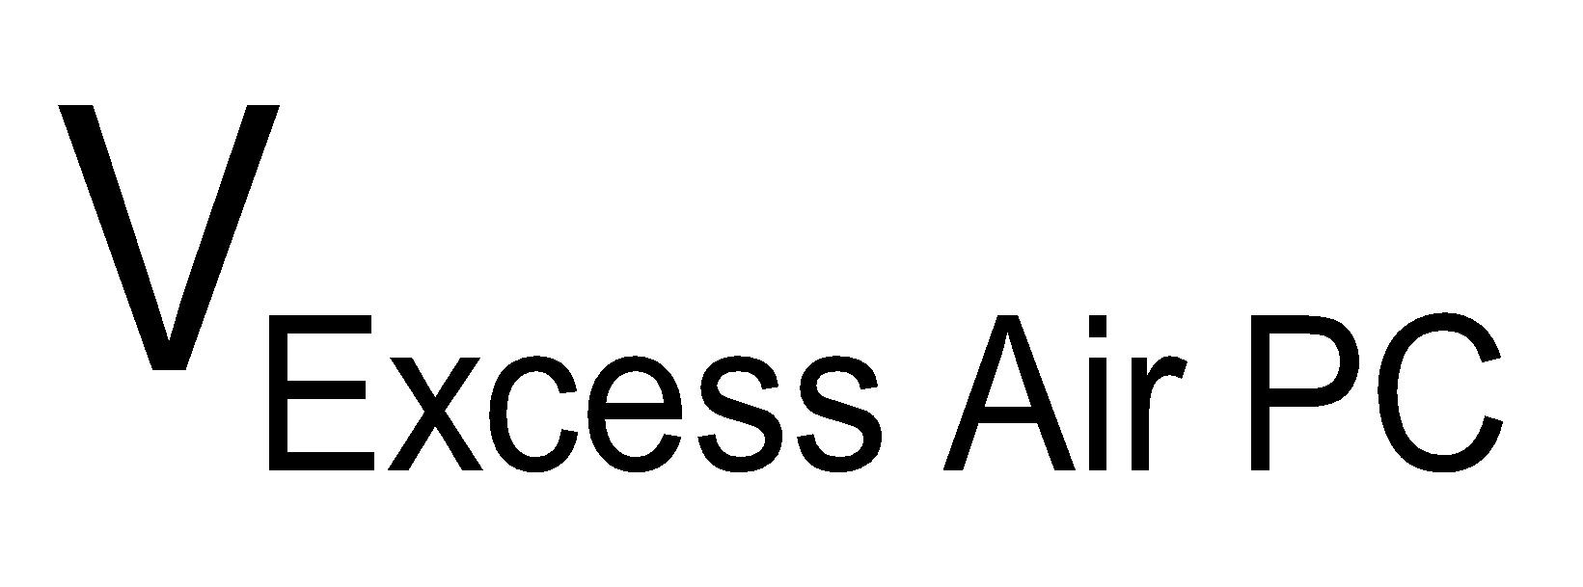
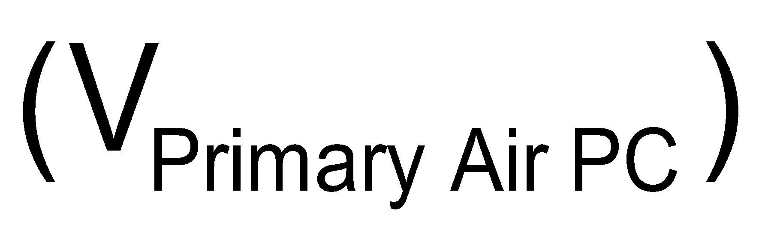

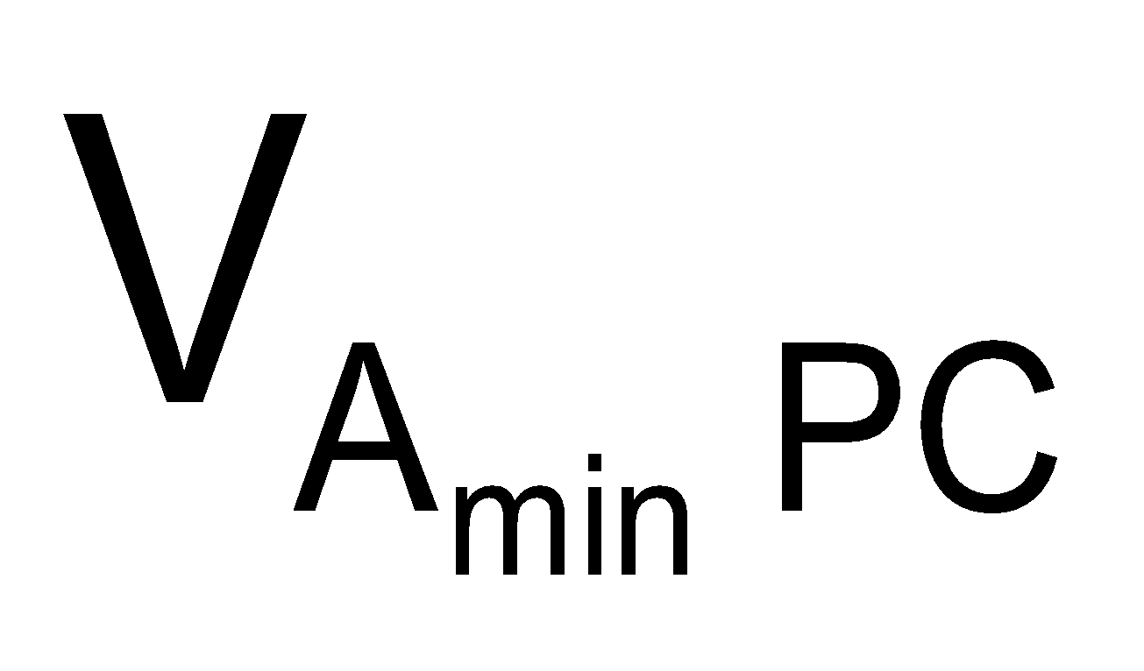

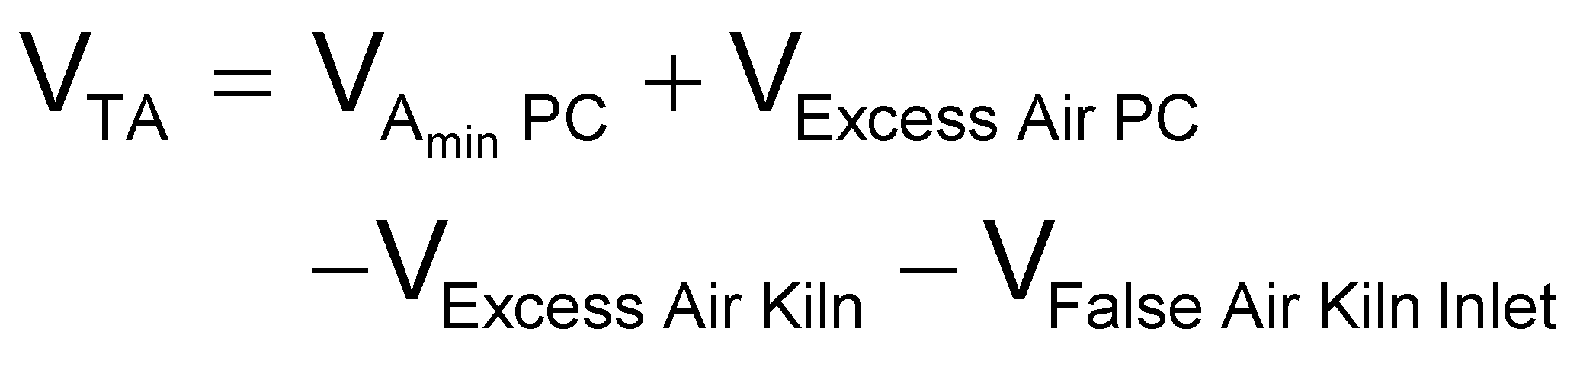


How to calculate the tertiary air flow?
Tertiary air flow (V_{TA})
Air balance
Here :

Slide 4
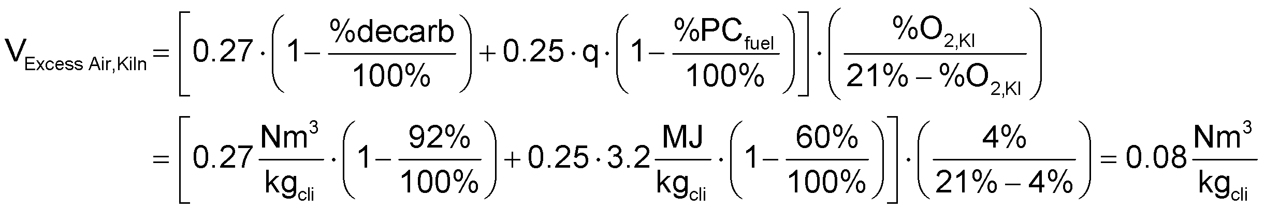
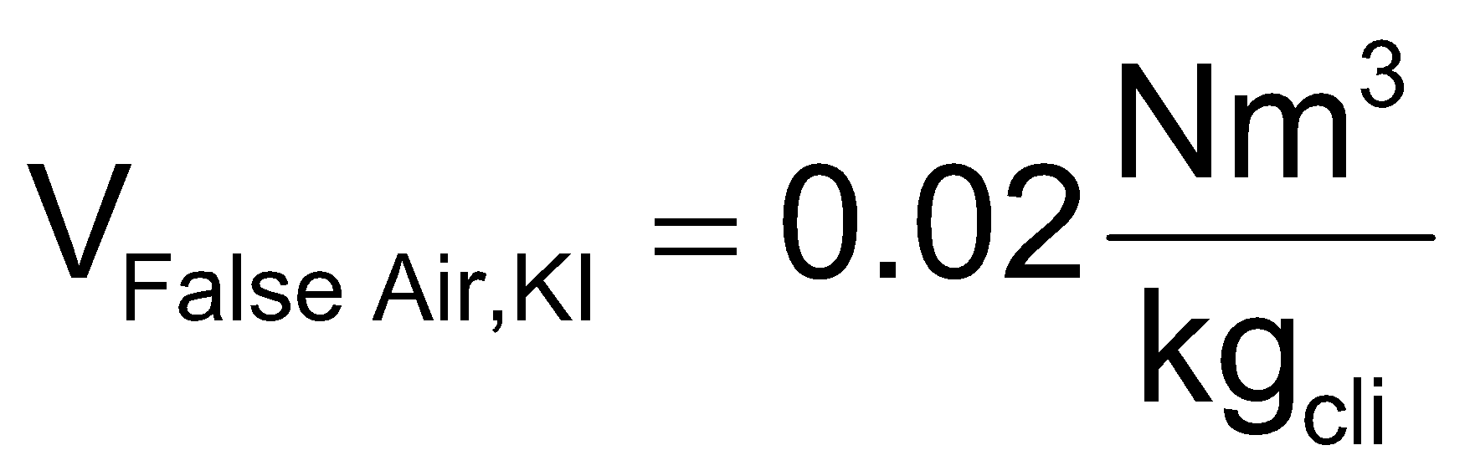
Calculations of each individual air flow
Air consumed by combustion in the PC
Excess air leaving the PC
Excess air from the kiln
False air between kiln and PC

Slide 5
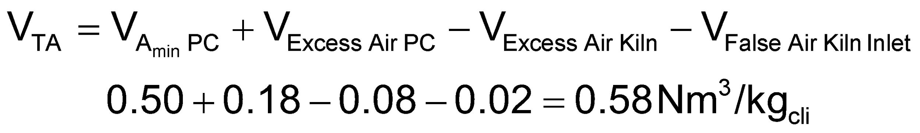

Tertiary air flow (in Nm³)
Specific tertiary air flow
Clinker production
Tertiary air flow

Slide 6
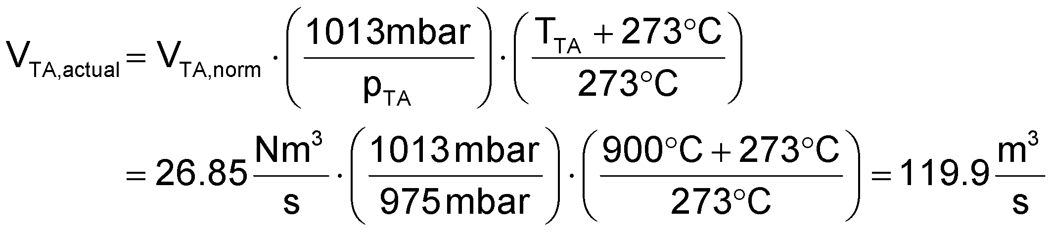

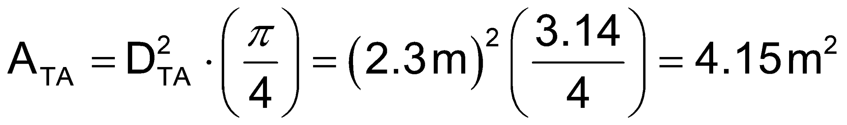
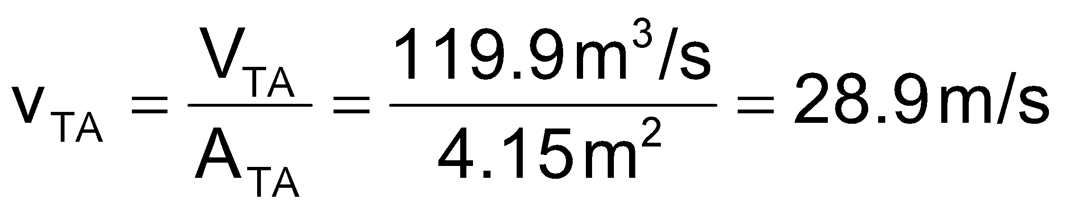
Tertiary air flow velocity (m/s)
Conversion from normal conditions to actual conditions
TA duct cross section
Velocity in TA duct
Guideline: v_{TA} > 25 m/s → to avoid settling of clinker dust in the tertiary air duct v_{TA} > 30 m/s → design for new installations at nominal gas flow

